Slide 1
Arrays and Lists
Notes:
To create Em dash above headline:
Same size and weight as the headline and set using a soft return.
PC: Em dash (—): Alt+Ctrl+ - (minus)
Mac: Em dash (—): Shift+Alt/Option+hyphen

Slide 2
Agenda
Arrays
Singly Linked List
Doubly Linked List
Special Lists

Slide 3
1. Overview
Notes:
To create Em dash above headline:
Same size and weight as the headline and set using a soft return.
PC: Em dash (—): Alt+Ctrl+ - (minus)
Mac: Em dash (—): Shift+Alt/Option+hyphen

Slide 4
Learning Objectives
Understand the structure and operations of:
Arrays
Singly and Doubly Linked Lists
Array-based and Circular Lists
Be able to implement the above data structures

Slide 5
2. Arrays
Notes:
To create Em dash above headline:
Same size and weight as the headline and set using a soft return.
PC: Em dash (—): Alt+Ctrl+ - (minus)
Mac: Em dash (—): Shift+Alt/Option+hyphen

Slide 6
Case Study
RMIT needs to keep track of its student records which store information about the students such as student id, name, email, address, phone, courses taken and results, courses enrolment for current and future semesters, etc.
Propose a data structure that you would use to keep tracks of these student records
Justify that your selected data structure is highly suitable for the problem

Slide 7
Array
Arrays are objects of a “built-in” class in Java, which can be used to store a fixed number of elements of the same type.
There are other types of “arrays” implemented in packages
Elements in an array can be accessed via indices, ranging from 0 to (array.length – 1).
Notes:
Since the size of array is known, it is natural to use a for loop to traverse

Slide 8
Array
An array is formed via 3 steps: declare, create, and initialise.
// declare -> no memory allocation at this point
int[] a;
// create -> allocate memory
a = new int[5];
// initialize ; only assign one element at a time
a[0] = 1;
…
// another way: int[] a = {1, 2, 3, 4, 5};
Notes:
The other way is called “array initializer”
Note that this will return a syntax error: double[] myList; myList = {1, 2, 3, 4, 5}; (2 lines)

Slide 9
Array
Without initialisation, array elements are set to default values.
0 for numeric data types
\u0000 for char types
false for boolean types
If you want to change the number of elements in an array, the only way is to create a new array then clone the data to the new array.

Slide 10
Multi-dimensional Array
You can use a multi-dimensional array to store a matrix or a table (first brackets are for rows; second brackets are for columns)
double[][] distances = {0, 2, 5, 1,
2, 0, 3, 2,
5, 3, 0, 1,
1, 2, 1, 0}

Slide 11
Multi-dimensional Array
double[][] distances = {0, 2, 5, 1,
2, 0, 3, 2,
5, 3, 0, 1,
1, 2, 1, 0}
distances[0][2] = 5;
distances[3][1] = 2;

Slide 12
Multi-dimensional Array
Calling the function .length for a multi-dimensional array will return the number of elements within the array, i.e., the number of rows
Each element have its own length, i.e., the number of columns
int[][] x = new [3][4];
x.length = 3;
x[0].length = x[1].length = x[2].length = 4;

Slide 13
Multi-dimensional Array
Elemental arrays can have different lengths, but must be of the same type.
int[][] b = {
{1,2,3,4},
{0,100}
};
1 | 2 | 3 | 4
b[0]
b[1]
0 | 100
Notes:
The example is called “ragged array”

Slide 14
Multi-dimensional Array
Applications:
Storing and processing students’ marks, MCQs
Finding the closest pair
Sudoku game
…

Slide 15
Multi-dimensional Array
Elements of array can also be arrays. Thus n-dimensional arrays can be created:
// create integer array of size 2*3*4
int[][][] a = new [2][3][4];
// rows = 2, columns = 3, cells = 4
{0,0,0,0} | {0,0,0,1} | {0,0,1,0}
{0,1,0,0} | {1,0,0,0} | {1,1,1,1}
Notes:
Two students, three exams, four questions each

Slide 16
Multi-dimensional Array
// create integer array of size 2*3*4
int[][][] a = {
{{0,0,0,0}, {0,0,0,1}, {0,0,1,0}},
{{0,1,0,0}, {1,0,0,0}, {1,1,1,1}}
};
// 1st row, 2nd column, 1st element
a[0][1][0] = 0;
{0,0,0,0} | {0,0,0,1} | {0,0,1,0}
{0,1,0,0} | {1,0,0,0} | {1,1,1,1}
Notes:
Two students, three exams, four questions each

Slide 17
Array – Disadvantages
We can have an array of objects, where each element holds a reference to each of those objects. For example:
// array of Strings of varied lengths
String[] s = new String[10];
How to insert “a” at the beginning?
data | b | c | d | e | f
index | 0 | 1 | 2 | 3 | 4 | 5 | 6 | 7 | 8 | 9

Slide 18
Array – Disadvantages
How to insert an element into a full array?
How to remove an element at the beginning
data | b | c | d | e | f
index | 0 | 1 | 2 | 3 | 4 | 5 | 6 | 7 | 8 | 9
data | a | b | c | d | e | f
index | 0 | 1 | 2 | 3 | 4 | 5 | 6 | 7 | 8 | 9

Slide 19
Array – Time & Space Complexity
ARRAY | Average | Worst
Access | O(1) | O(1)
Search | O(n) | O(n)
Insertion | O(n) | O(n)
Deletion | O(n) | O(n)
Space |  | O(n)

Slide 20
Array – Time & Space Complexity
As an object, the actual memory size of an array may be larger than the memory needed to store its data elements.
Accessing an array element takes a constant time O(1).
But changing array size involve creating new array and transferring data, which is computationally expensive!

Slide 21
Array – Performance Analysis
Strengths:
Convenient for storing and processing a collection of data
Randomly access in constant time
Weaknesses:
Fixed size → have to determine array size upfront
Inserting or removing elements are costly
Notes:
The reason: memory allocation for each element is interdependent and fixed when array is created.

Slide 22
Array – Performance Analysis
We need another data structure:
faster to insert/remove,
can be expanded/shrunk easily
→ Linked List

Slide 23
2. Singly Linked Lists
Notes:
To create Em dash above headline:
Same size and weight as the headline and set using a soft return.
PC: Em dash (—): Alt+Ctrl+ - (minus)
Mac: Em dash (—): Shift+Alt/Option+hyphen

Slide 24
Linked List
Linked list is a sequence of nodes; each node has connection(s) to the node(s) next to it.
What is a node? Think about a cabin in a train
Space to contain data (the cabin)
Reference(s) to the next node(s) (the hooks)
Add/insert/remove elements → just update the hooks

Slide 25

Linked List (SLL)
The first node in the sequence is the head, the last node in the sequence is the tail. The head is referred to by the list instance. The tail refers to nothing (is null).
An integer is normally used to keep track of list size.
class List { Node head, tail; int length;
…
}

Slide 26
SLL – Simple Implementation
public class SLL {
Node head, tail;
int length;
// create a list of 1 node
public SLL(int value) {
head = new Node(value);
tail = head;
length = 1;
}
}

Slide 27
SLL – Append
public class SLL {
Node head, tail;
int length;
// Method to append a node to the list
public void appendNode(Node aNode) {
tail.next = aNode; // link tail to new node
tail = tail.next; // update new tail
length += 1; // keep track of size
}
}

Slide 28
SLL – Append
How about appending to the beginning of the SLL?
Create the new node and update its data
Hook it to the head
newNode.next = head
Update head reference
head = head.prev

Slide 29

SLL – Insert after $i^{th}$ Node
Node addAfter(Node w, int data) {
Node u = new Node(data);
u.next = w.next;
w.next = u;
length++;
return u;
}
void add(int i, int data) {
addAfter(getNode(i), data);
}

Slide 30
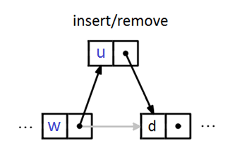

SLL – Remove $i^{th}$ Node
void remove(int i) { // assume i >= 0 if (i == 0) { head = head.next; } else if (i > 0) { Node prev = getNode(i - 1); Node cur = prev.next; prev.next = cur.next; } length--; }

Slide 31

SSL – Search
Find $i^{th}$ node: starting from head node, then traverse the list to reach the node of interest → it is O(n), however, traversing is very fast.
public Node getNode(int i) {
Node p = head;
for (int j = 0; j < i; j++)
if (p != null) p = p.next;
return p;
}
Cannot traverse in backward direction

Slide 32

SSL – Get Node Value
Get value of $i^{th}$ node:
public int get(int i) {
return getNode(i).data;
}

Slide 33

SSL – Set Node Value
Set value of $i^{th}$ node:
public int set(int i, int data) {
Node u = getNode(i);
int oldData = u.data;
u.data = data;
return oldData;
}

Slide 34
SLL – Print
public class SLL {
Node head, tail;
// Method to print the nodes in a list
public void printList() {
Node cur = head;
while (cur != null) {
System.out.println(cur.data);
cur = cur.next; // traverse the list
}
}
}

Slide 35
3. Doubly Linked Lists
Notes:
To create Em dash above headline:
Same size and weight as the headline and set using a soft return.
PC: Em dash (—): Alt+Ctrl+ - (minus)
Mac: Em dash (—): Shift+Alt/Option+hyphen

Slide 36
Doubly Linked List (DLL)
DLL is very similar to SLL, however each node in DLL (except head and tail) has references to both the node follows it and the node precedes it.
class DNode { // data of generic type T
T x;
// reference to adjacent DNodes
DNode prev, next; }

Slide 37
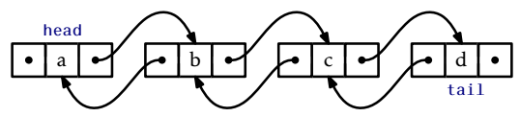
Doubly Linked List (DLL)
In DLL, head.prev and tail.next are null.
Alternatively, a dummy node may be created to be referenced from and to the tail and the head respectively
Notes:
When implementing an SLList, we saw that there were always several special cases to worry about. For example, removing the last element from an SLList or adding an element to an empty SLList requires care to ensure that head and tail are correctly updated. In a DLList, the number of these special cases increases considerably. Perhaps the cleanest way to take care of all these special cases in a DLList is to introduce a dummy node. This is a node that does not contain any data, but acts as a placeholder so that there are no special nodes; every node has both a next and a prev, with dummy acting as the node that follows the last node in the list and that precedes the first node in the list.

Slide 38
DLL – Simple Implementation
// Implement the Node class
public class Node {
int data;
Node prev, next;
public Node(int value) {
data = value;
prev = null;
next = null;
}
}
(Node) prev | (Node) next
(int) data

Slide 39
DLL – Simple Implementation
// Implement the Doubly Linked List class
public class DLL {
Node head, tail;
int length;
public DLL(int value) { // create a list of 1 node
head = new Node(value);
tail = head;
length = 1;
}
}

Slide 40
DLL – Append
public void appendNode(Node aNode) {
tail.next = aNode; // at the end of the list
aNode.prev = tail;
tail = tail.next;
length += 1; // keep track of size
}

Slide 41
DLL – Print
public void printList() {
Node cur = head;
while (cur != null) {
System.out.println(cur.data);
current = cur.next; // traverse the list
}
}

Slide 42
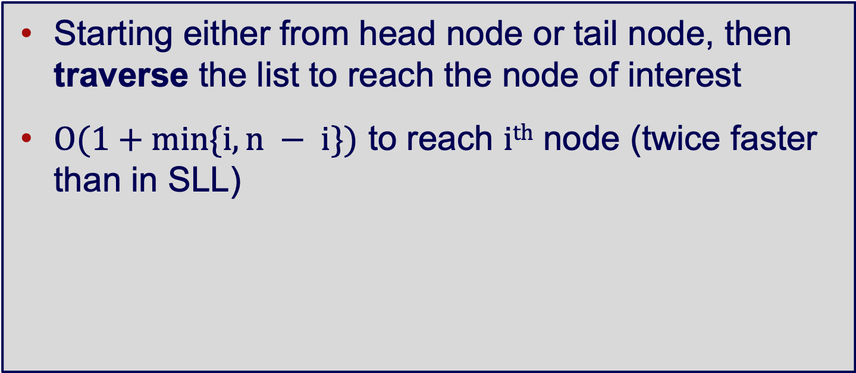
DLL – Search
Starting either from head node or tail node, then traverse the list to reach the node of interest
$O(1+min⁡\{i, n − i\})$ to reach $ith$ node (twice faster than in SLL)
Notes:
N = 5, I = 4, O(1 + min(4, 5-4)) = O(2)

Slide 43

DLL – Search
Node getNode(int i) { Node p = null; if (i < n / 2) { p = head; for (int j = 0; j < i; j++) p = p.next; } else { p = tail; for (int j = n-1; j > i; j--) p = p.prev; } return p; }
Does that mean DLL is better than SLL?
→ There are twice number of references to handle.
Get and set value of $i^{th}$ node: similar to SLL

Slide 44
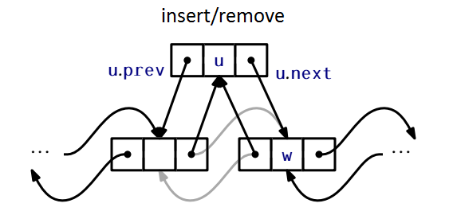

DLL – Insert before $i^{th}$ Node
Node addBefore(Node w, T data) { Node u = new Node(); u.data = data;
u.prev = w.prev; u.next = w;
u.next.prev = u; u.prev.next = u;
length++; return u; }

Slide 45
DLL – Remove Node
void remove(Node w) { w.prev.next = w.next; w.next.prev = w.prev; length--; }

Slide 46
LL – Time & Space Complexity
Linked List | Average SLL / DLL | Worst SLL / DLL
Access | O(n) / O(n) | O(n) / O(n)
Search | O(n) / O(n) | O(n) / O(n)
Insertion | O(1) / O(1) | O(1) / O(1)
Deletion | O(1) / O(1) | O(1) / O(1)
Space |  | O(n) / O(n)
Notes:
DLL search by orthodox way

Slide 47
Linked List – Space Complexity
Flexible size
Need space to store references and object header
Compare to arrays, what is better, what is worse?
What happen if references were not updates properly?

Slide 48
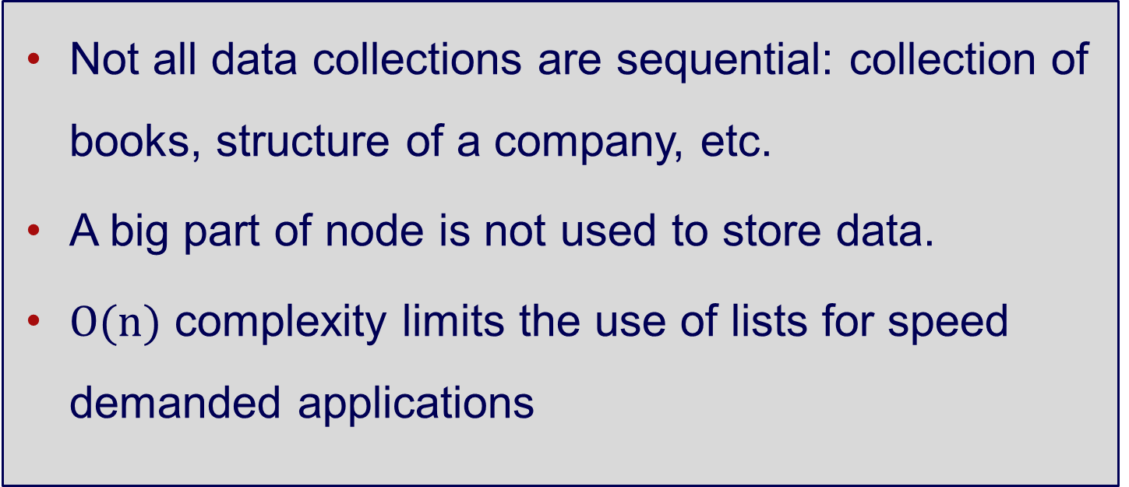
Linked List – Disadvantages
Not all data collections are sequential: collection of books, structure of a company, etc.
A big part of node is not used to store data.
$O(n)$ complexity limits the use of lists for speed demanded applications

Slide 49
Linked List – Disadvantages
Can you find a way to reduce the O(n) time complexity?

Slide 50
4. Special Lists
Notes:
To create Em dash above headline:
Same size and weight as the headline and set using a soft return.
PC: Em dash (—): Alt+Ctrl+ - (minus)
Mac: Em dash (—): Shift+Alt/Option+hyphen

Slide 51
Array-based List
Depend on the application, either the constant time access or the changeable size gets favour.
If access time is more important, a list can be built on a array.
Array indices play role of references.

Slide 52

Array-based List
An array larger than the list size is normally used to reserve some space.
If the list size grows exceeded array size, then new array is created and data is transfer.

Slide 53
Circular List
In both SLL and DLL, we have to keep track of head and tail references.
Mistakes in updating these two references may result in data lost or program failure.

Slide 54
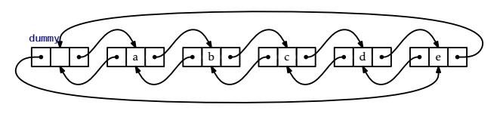
Circular List
One way to avoid those reference stuff is to use a circular DLL.
In this structure, the tail and head are connected to each other to make a circle, and a dummy node (contains no data) is used as a starting point of the list.

Slide 55
Discussion and Exercises

Slide 56
Floyd's Cycle Detection Algorithm
Aka as the “Tortoise and Hare Algorithm"
Start Tortoise and Hare at the first node of the List
If Hare reaches end of the List, return as there is no loop in the list
Else move Hare one step forward
If Hare reaches end of the List, return as there is no loop in the list
Else move Hare and Tortoise one step forward
If Hare and Tortoise point to same Node - return, found loop in the List
Else start with STEP 2

Slide 57
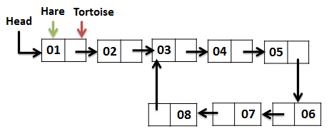
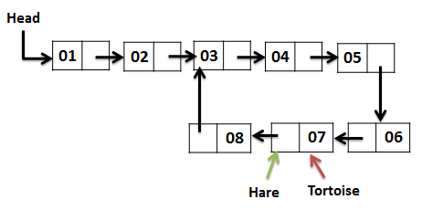
Floyd’s Algorithm
The pattern of Hare and Tortoise movements are shown below. Hare Tortoise 1 1 3 2 5 3 7 4 3 5 5 6 7 7
Complexity: Time Complexity: O(n)
Space Complexity: O(1)

Slide 58
How would you solve these?
Remove the loop in a linked list
Print every second entry in a linked list
Print/delete the middle element of a linked list
How to remove duplicates in a linked list?
How do you swap every two nodes in a linked list without moving the data: For example 1, 2, 3, 4, 5, 6 becomes 2, 1, 4, 3, 6, 5
Notes:
How to remove the loop in a linked list
Count the number of nodes in loop. Let count be k
Fix one pointer to the head and another to k^{th} node from head
Move both pointers at the same pace until they meet
Get pointer to the last node of loop and make next = NULL

Slide 59
To finish…

Slide 60
Learning Objectives
Understand the structure and operations of:
Array
Singly and Doubly Linked Lists
Array-based and Circular Lists
Be able to implement the above data structures

